Slide 1

Digital Counter
Group Members:
Muhammad Amjad 02-131202-041
Muhammad Ameer Hamza 02-131202-037
Muhammad Junaid Saleem Qadri 02-131202-057
Course :
Computer Architecture and logic Design
Course Teacher:
Sir Samar Yazdani
Lab Teacher:
Engr.Ramsha Mashood
Department Of Software Engineering

Slide 2
INTRODUCTION
Counters used in stopwatch, calculator, etc
7 Segment Display best component to display number.
Main Components of our project are & Segment Display and IC 4026

Slide 3
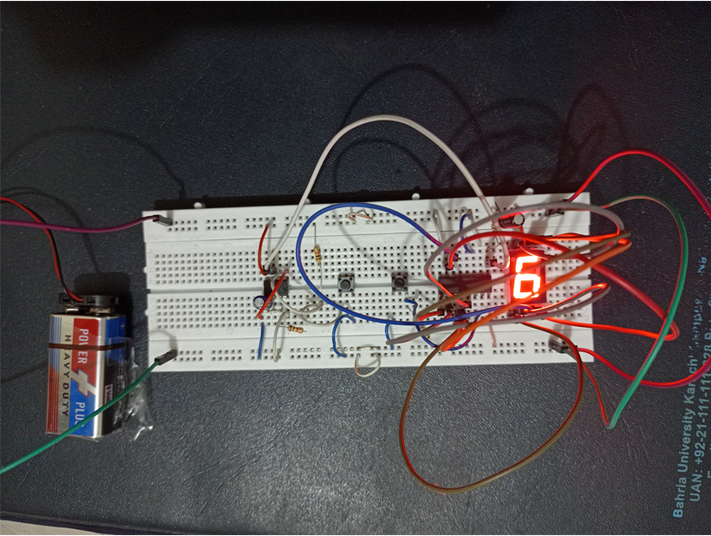

Slide 4
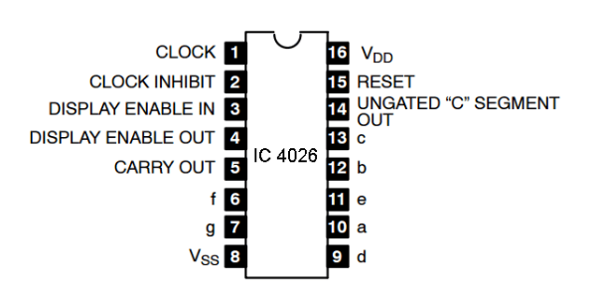
IC 4026

Slide 5
IC 4026
PIN Number | Name | Description
1 | Clock | Increment the Counter
2 | Click Inhibit | When low, clock pulses increment the seven-segment. Freezes the counter when HIGH, active HIGH.
3 | DEI | ON when this pin is HIGH. OFF if it is LOW.
6 | F | Connected to ‘f’ of the 7 segment.
7 | G | Connected to ‘g’ of the 7 segment.

Slide 6
IC 4026 (Continue)
PIN Number | Name | Description
8 | VSS | Ground Pin
9 | D | Connected to ‘d’ of the 7 segment.
10 | A | Connected to ‘a’ of the 7 segment.
11 | E | Connected to ‘e’ of the 7 segment.
12 | B | Connected to ‘b’ of the 7 segment.
13 | C | Connected to ‘c’ of the 7 segment.

Slide 7
IC 4026 (Continue)
PIN Number | Name | Description
15 | RST | Reset PIN, active HIGH. Reset the counter to 0 when HIGH.
16 | VDD | Power supply PIN

Slide 8
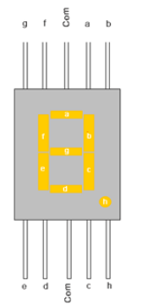
7 Segment Display Counter

Slide 9
Components
555 timer IC
4026 IC
Common cathode 7 segment display
Two- push ON, push OFF button.
Resistors – 10k (3), 100k
Capacitor 1uF, 22uF

Slide 10
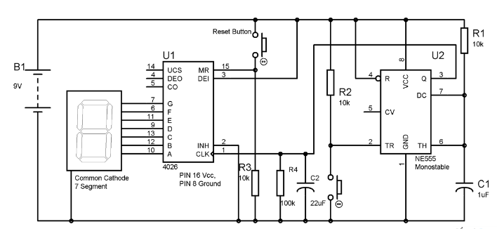
Circuit Diagram

Slide 11
TARGET MARKET
Digital Clock , Counter and Calculator

Slide 12
Description
PIN 4,5,14 are not used.
PIN 15 used to Reset the counter with the help of a PUSH button Switch.
PIN 2 is kept LOW to avoiding the freezing.
PIN 13 is kept HIGH to enable the IC
555 timer is used here to provide the clock pulse on each Button Press
We have also used a RC circuit (22uf capacitor and 100k resistor) at CLOCK PIN 1 of 4026.

Slide 13
OVERVIEW
(Flow Diagram)
Counter button Pressed
Reset button Pressed
Increment Seven Segment Display
Reset Counter

Slide 14
ENHANCEMENT
Further Enhancement of this project will be implement on micro controller to get more better result

Slide 15
Thank You

